Slide 1
Account Takeover (ATO) Update
5 Aug 2022

Slide 2
Framework
Background of ATO;
2 important MOs of ATO;
Big picture for ATO detection;
Models result in 2 different scenarios;
Login step;
Order-create step;
Thanks;
2

Slide 3
Background
ATO definition: Fake-owners use all tricks to achieve true-owners’ accounts.
Aim: Use true-owners’ money to make profit directly.
Distribution of ATO Cases:
‘num_cc_ato': number of CC tickets whose case reasons are ATO;
‘num_cc_ato_order’: number of CC tickets which are additionally attached with ‘order_id’;
‘num_cc_ato_tag_seller_scam’: number of CC tickets which are tagged with ‘scam seller’;
3

Slide 4
2 Important MOs
Direct ATO Case (buyer id = 400007706358):
Account info-change
03-12 22:58:35
03-14 16:54:13
03-14 19:12:01
Scam-Seller ATO Case (buyer id = 400325922966):
Account info-change
06-19 22:58:35
06-21 01:48:55
06-21 16:01:51
06-21 16:21:23
Latest Normal Login
Abnormal Order Cancel
Abnormal Login
Abnormal Order Create
4

Slide 5
Big picture for ATO detection
Idea: For ATO detection, models should be made for different scenarios.
Info-change
Done Model
To-do Model
Related MO
Login
Refund
Scam-seller
Order-create
Direct ATO
5

Slide 6
Model in Login Scenario (Model Setting)
Idea: For login detection, mainly focus on the first abnormal login of those scam-seller cases.
Trigger point: new umid in previous 3 months.
Model: Random Forest
new ip2
new ip3
number of login
etc.
avg/std price
avg/std dscnt rate
avg/std ship fee
suspect payment method
etc.
max cancel rate for previous seller
max avg price for previous seller
etc.
number of different accounts for same umid
Abnormal environment
Order side
Seller side
Clustering
6

Slide 7
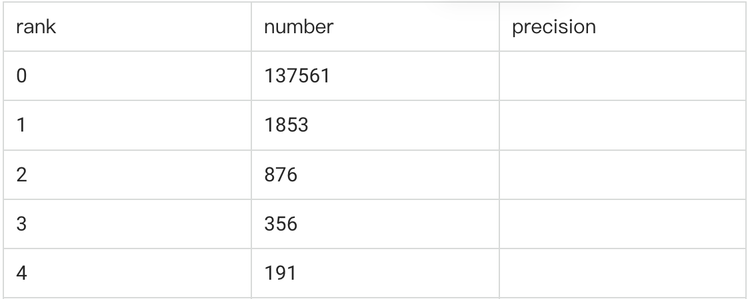
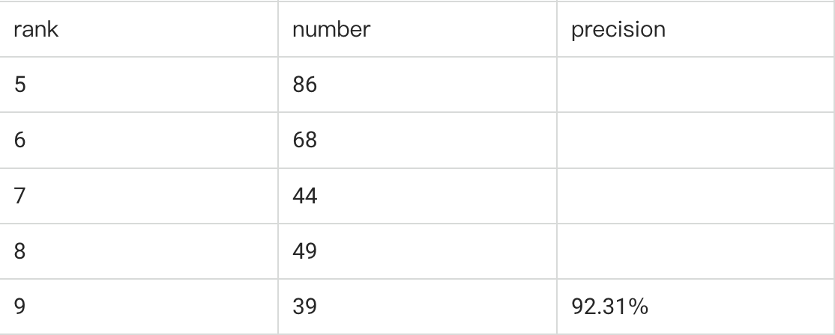
Model in Login Scenario (Model Performance)
Review Result
Data: 0621-0627 Login Records (140k)
Black Prediction: 65 cases (detection rate: 0.046%)
Precision: 81.25% after manually review
Recall: approximately 30%
Prediction score distribution
7

Slide 8
Model in Order-create Scenario (Model Setting)
Idea: For Order-create detection, mainly focus on those Direct ATO cases to compensate for login detection.
Time-line for each sample: ends at order-creation time, and starts from the closest login time with the same umid (as order-creation).
Model Architecture
Random Forest Model
Transformer Extractor
For Click Path
Statistical Feature Extractor For Click Path
Other Statistical Features
Order level
Info-change level
Click Path Sequence
Login level
8

Slide 9
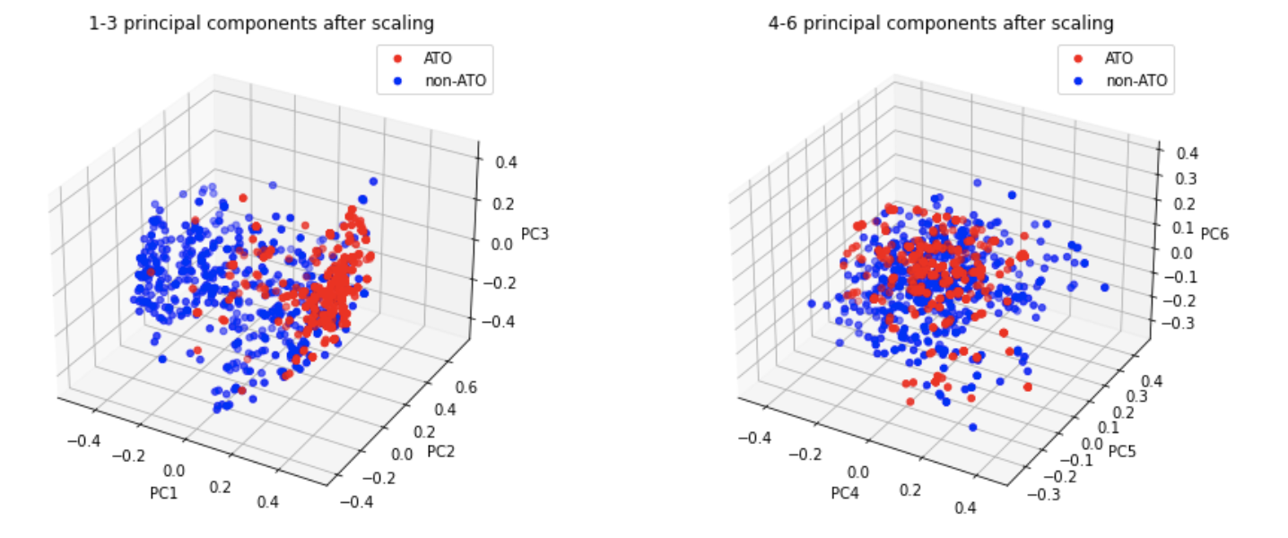
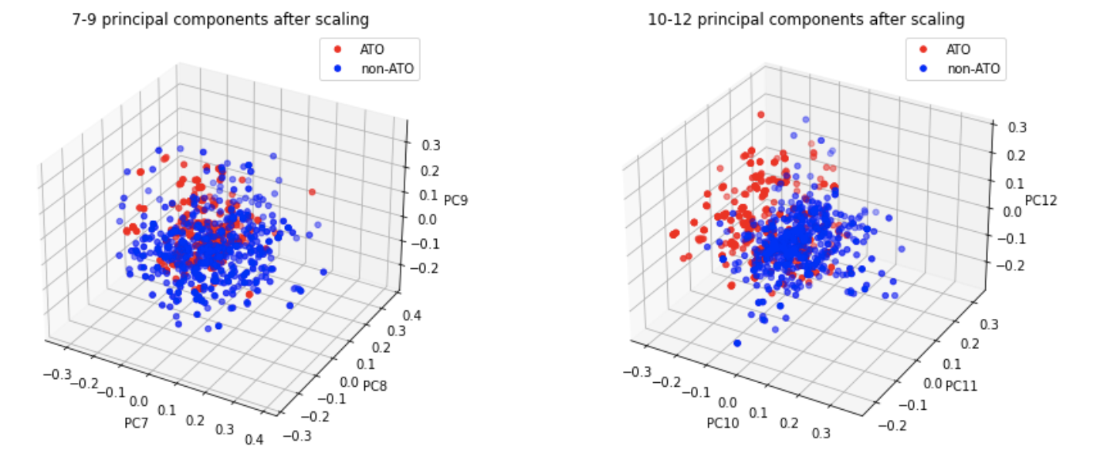
Model in Order-create Scenario (Model Performance)
Testing Set Performance
Only click path embedding:
Precision: 0.96
Recall: 0.88
Click path embedding + Statistical Features:
Precision: 0.98
Recall: 0.90
PCA analysis on embedding
9

Slide 10
Thanks everybody!!
10

